Slide 1
Lecture 37

Slide 2
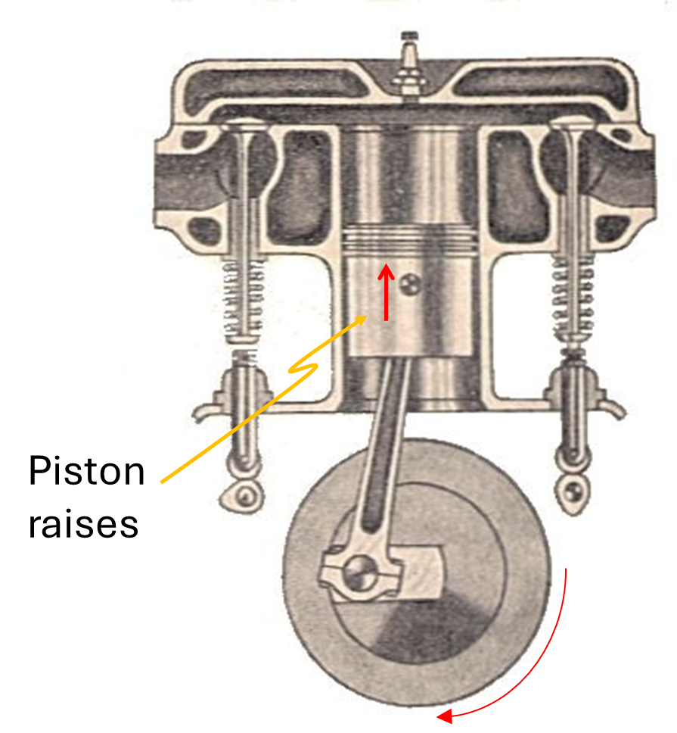
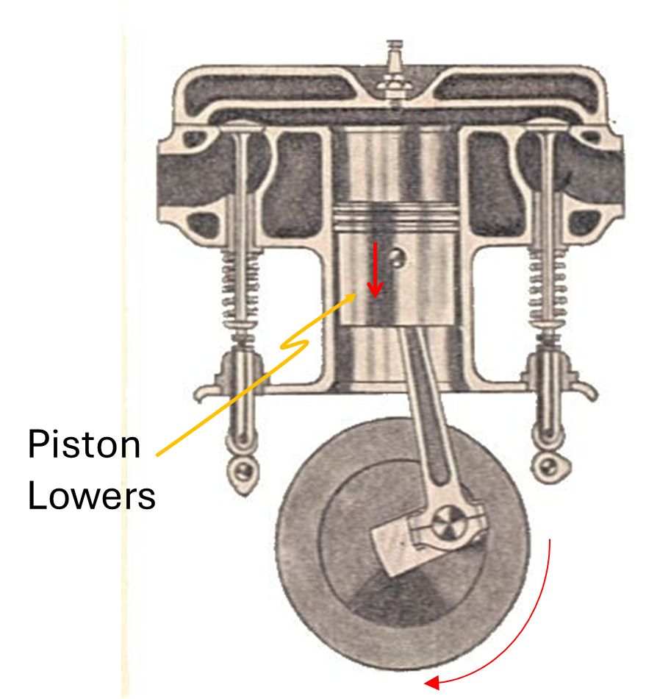
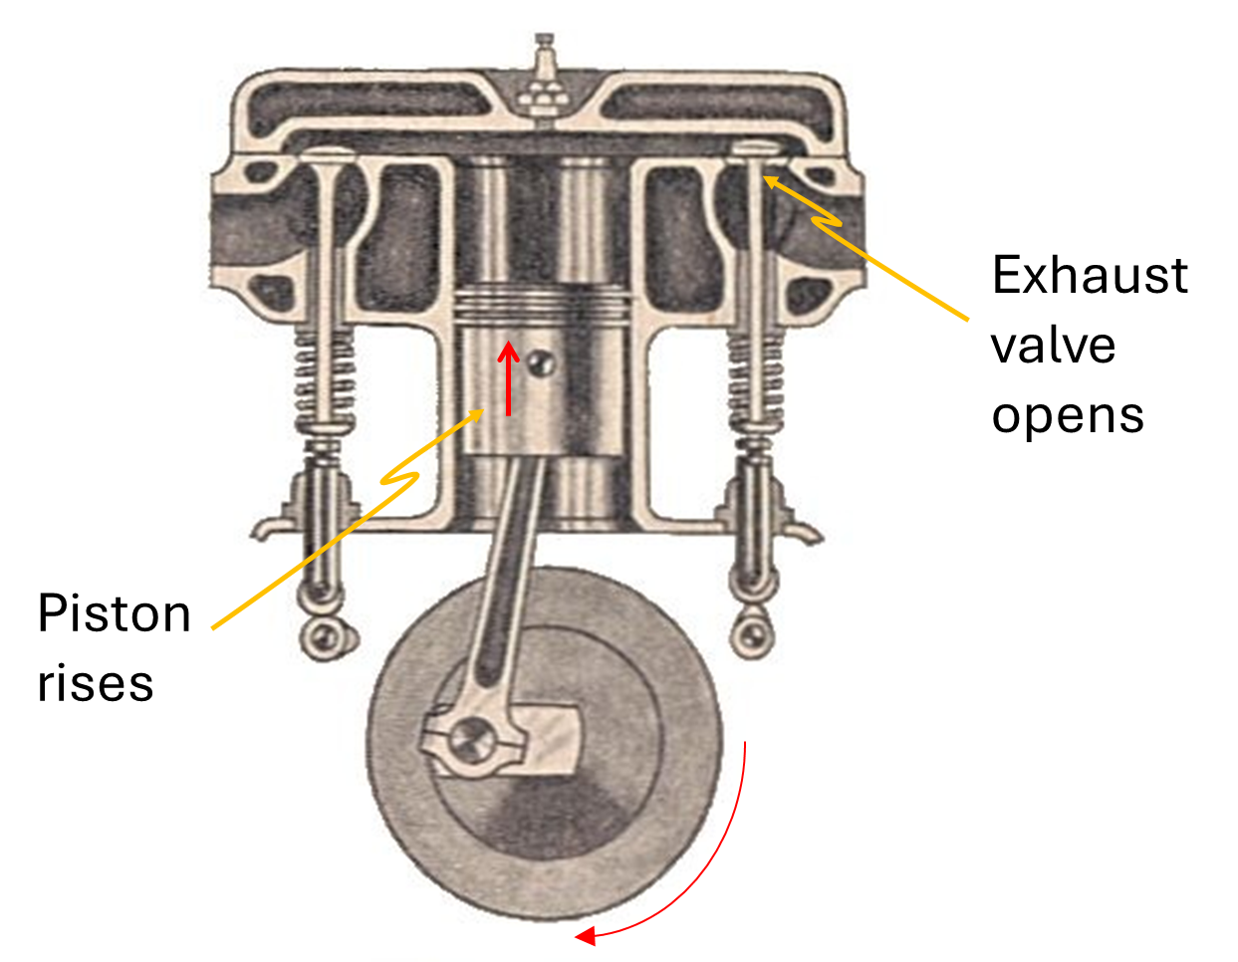
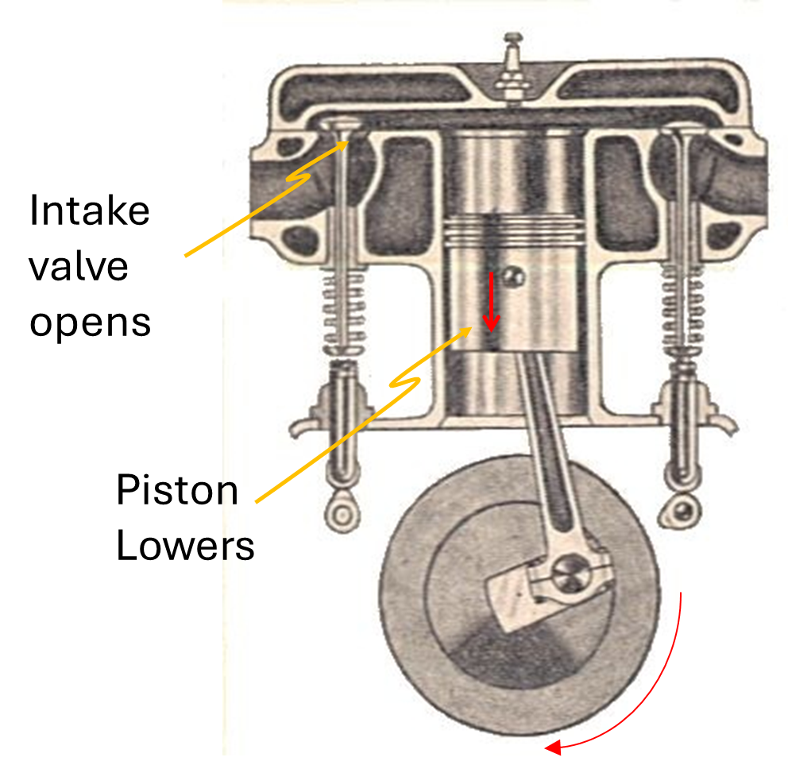
Process AB
Process CD (Power Stroke)
Process AI
Process IA
Otto Cycle
Manual of Driving and Maintenance for Mechanical Vehicles (Wheeled)

Slide 3
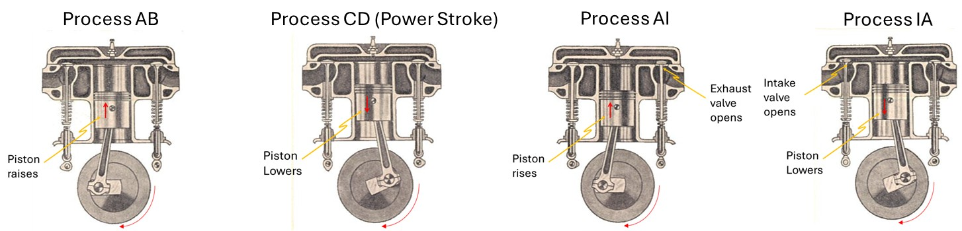
C
B
Pressure (Pa)
D
I
A
Volume (m³)

Slide 4
END

Slide 5
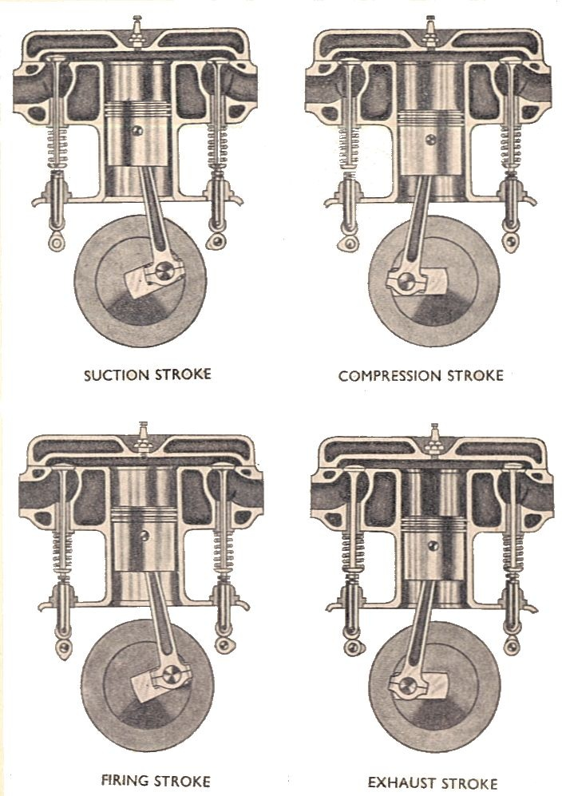
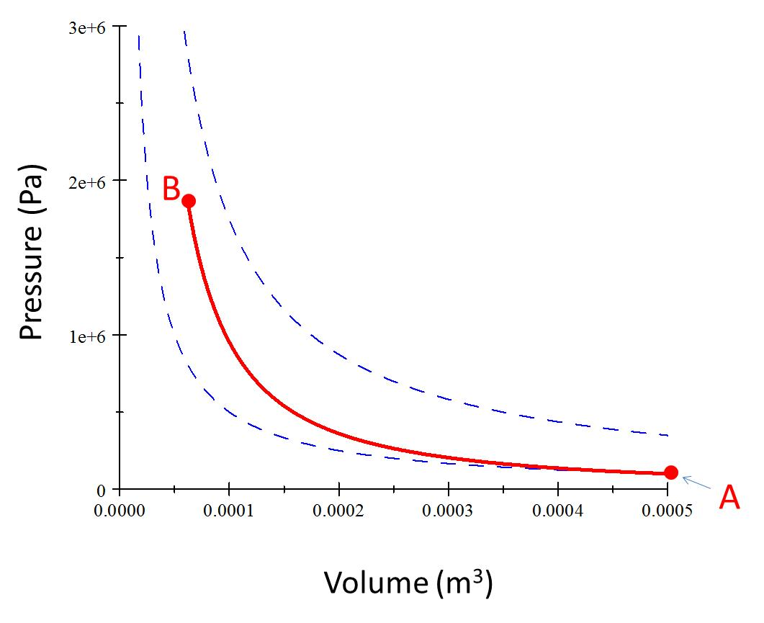
Process AB – Adiabatic Compression
Piston raises

Slide 6
Piston raises

Slide 7
C
B
Pressure (Pa)
Volume (m³)

Slide 8
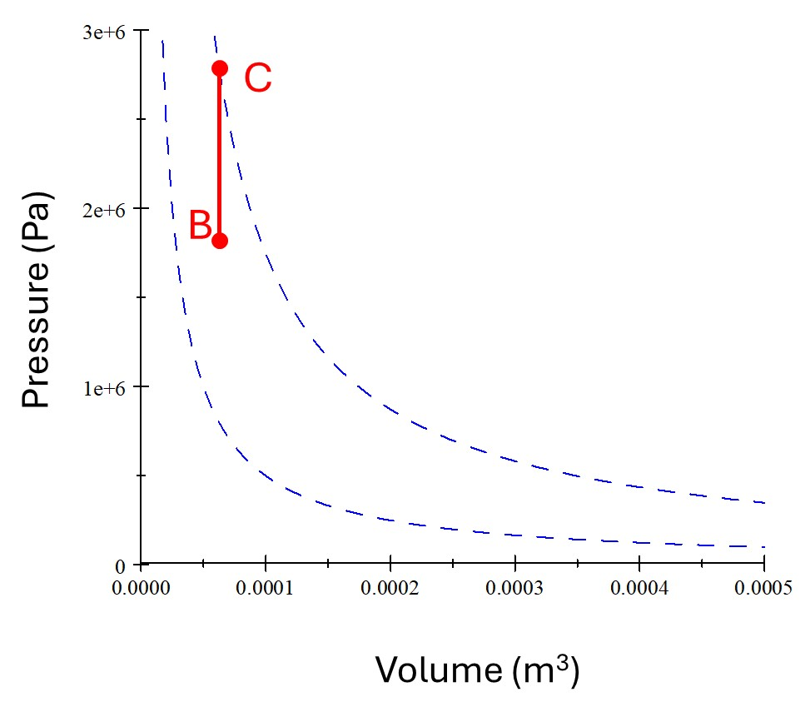

Slide 9
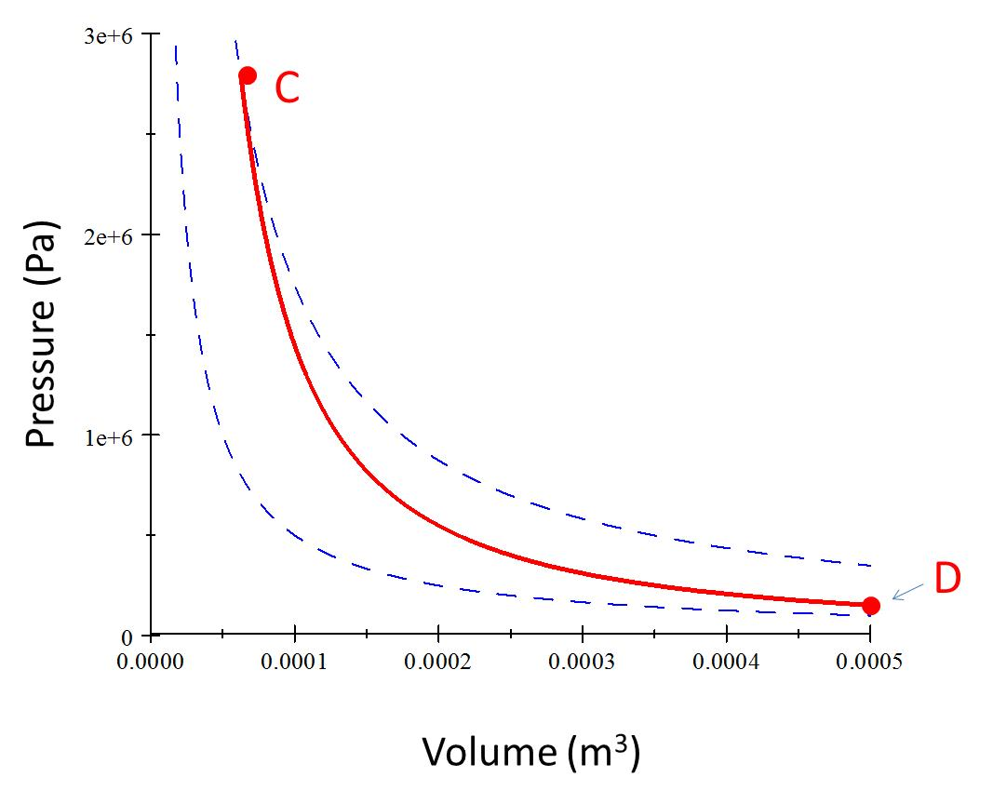
Process CD (Power Stroke)
Piston Lowers

Slide 11
Pressure (Pa)
D
A
Volume (m³)

Slide 12
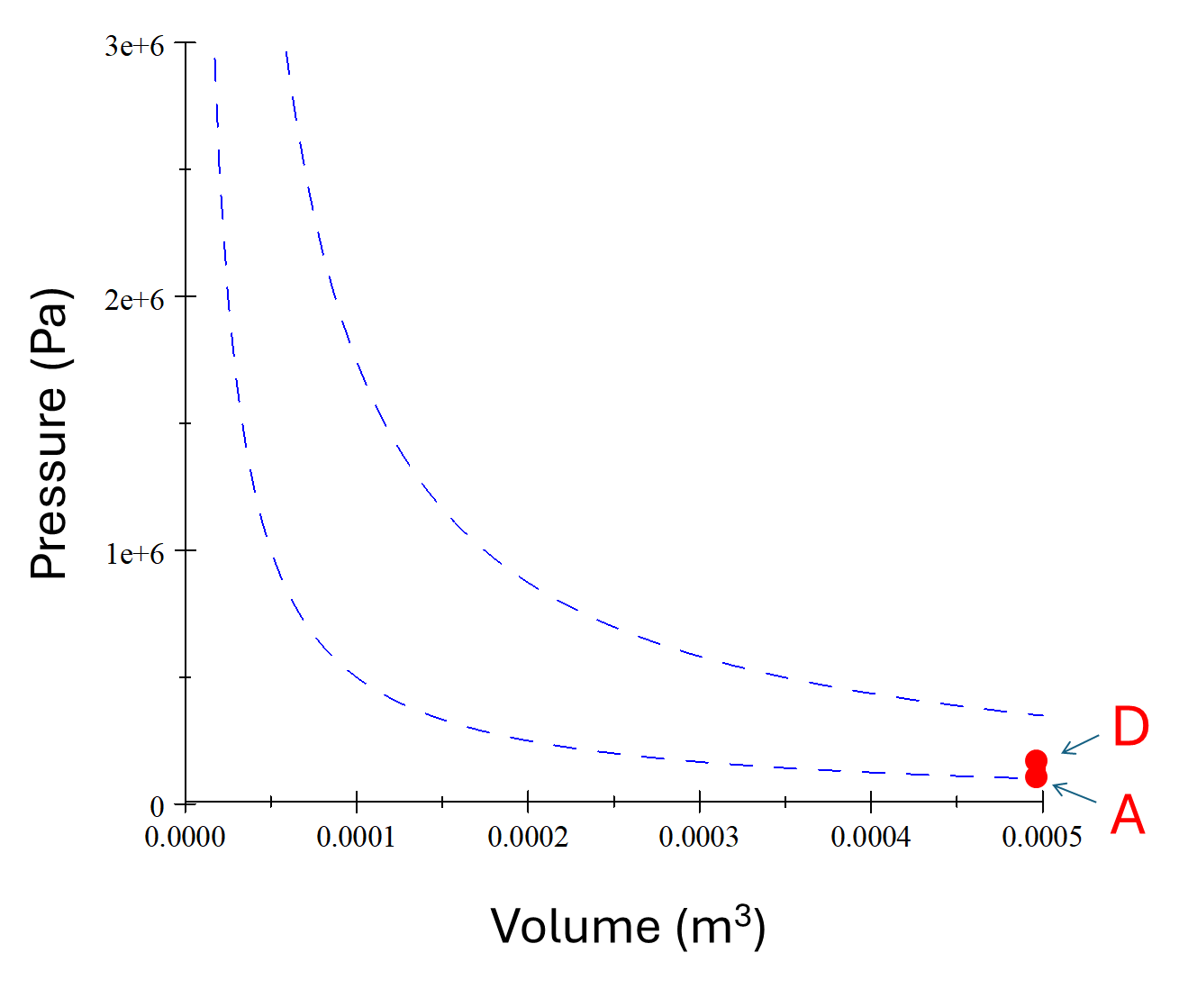

Slide 13
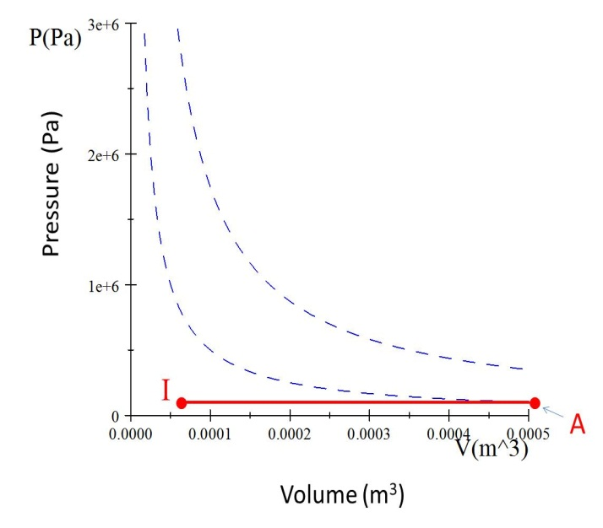
Process AI
Exhaust valve opens
Piston rises

Slide 14
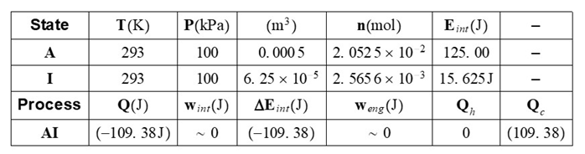

Slide 15
Process IA
Intake valve opens
Piston Lowers

Slide 16
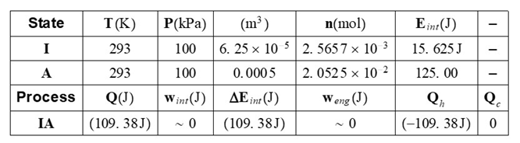

Slide 18
C
Q_{h}
B
Pressure (Pa)
Work Required
Useful Work Out
D
I
Q_{c}
A
Volume (m³)

Slide 19
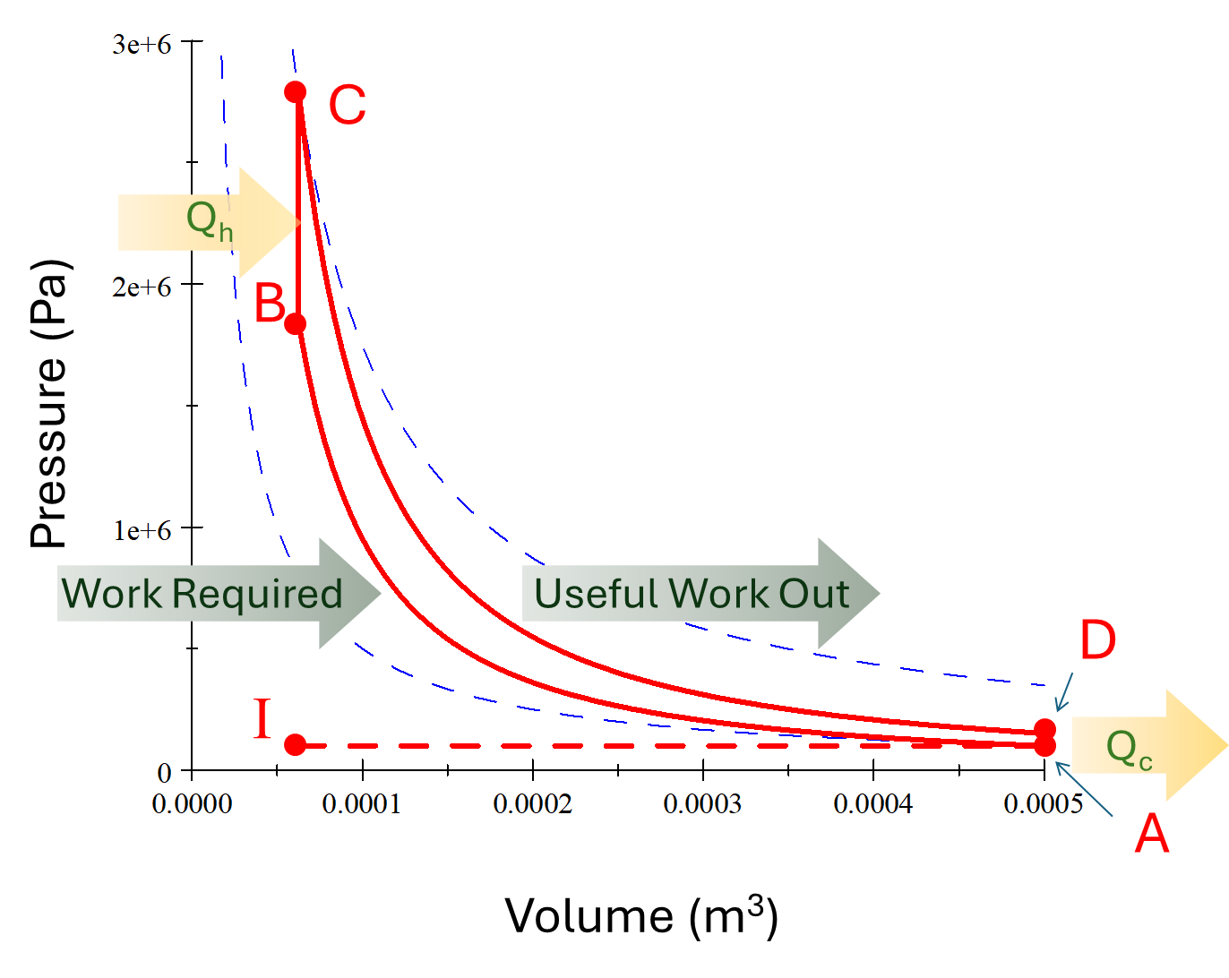

Slide 20
B
Pressure (Pa)
A
Volume (m³)

Slide 21
C
Pressure (Pa)
D
Volume (m³)

Slide 22
Pressure (Pa)
I
A
Volume (m³)

Slide 24
END

